Slide 1

Understanding and using LiDAR

Slide 2
What is LiDAR?
  LiDAR - Light Detection and Ranging
  LiDAR (Light Detection and Ranging) is a remote-sensing technology that uses laser light to measure distances and create highly accurate 3D maps and models of surfaces and objects.
  In metal detecting terms - LiDAR is a tool that strips away vegetation showing what the land under the vegetation looks like.

Slide 3
What LiDAR is not!
  A tool that lets you see underground. LiDAR only strips away the vegetation showing what the ground looks like.

Slide 4
What LiDAR can do!
LiDAR can:
Show man made changes to the earth
Roads and some trails but not old foot trails
Show the remains of buildings and forts where the ground has been worked
Places where extensive ground modification have occurred like cellars, crop rows, large wells, mills, water works, etc.
Fortification like trellises, trenches for troops etc.

Slide 5
LiDAR resources!
LiDAR resources can be found at:
https://detectingresearch.com/Lidar.htm

Slide 6
Civil War Forts

Slide 7
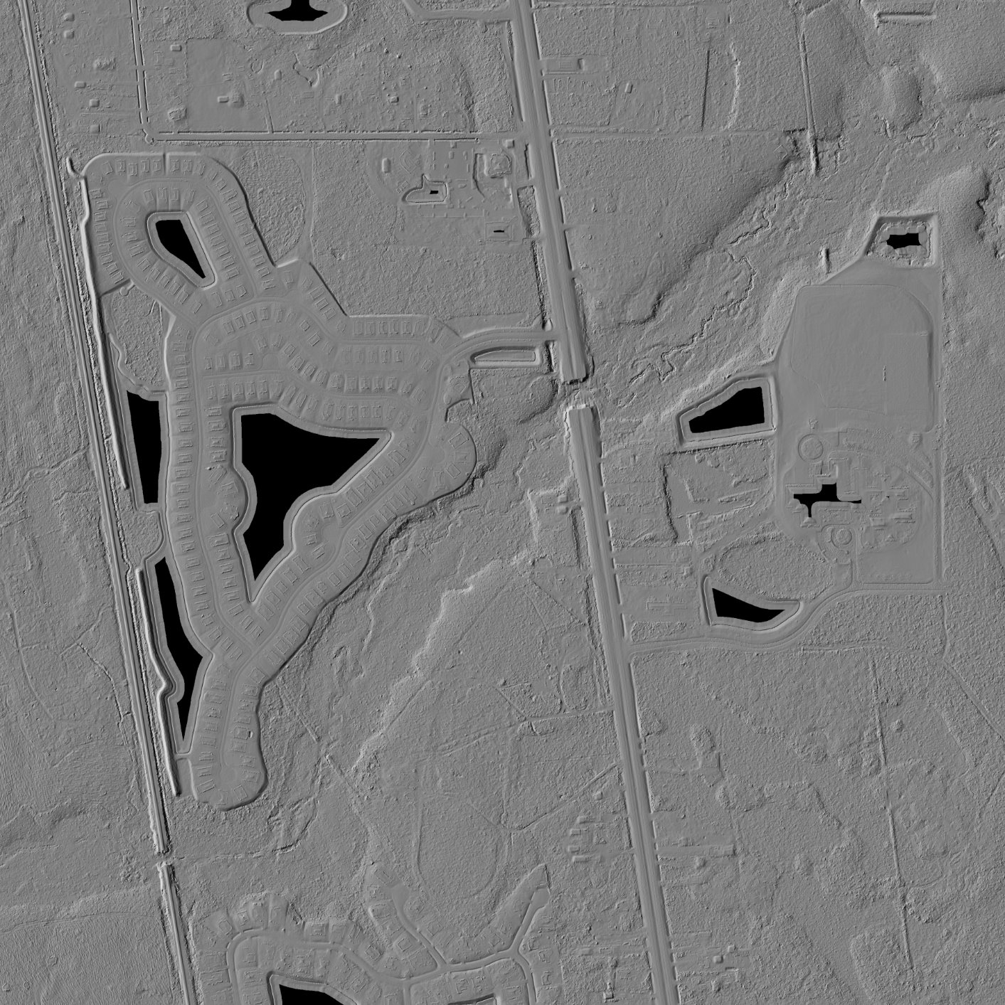
Fort Moultrie

Slide 8
Fort Peyton

Slide 9
Negro/Gadsen Fort

Slide 10
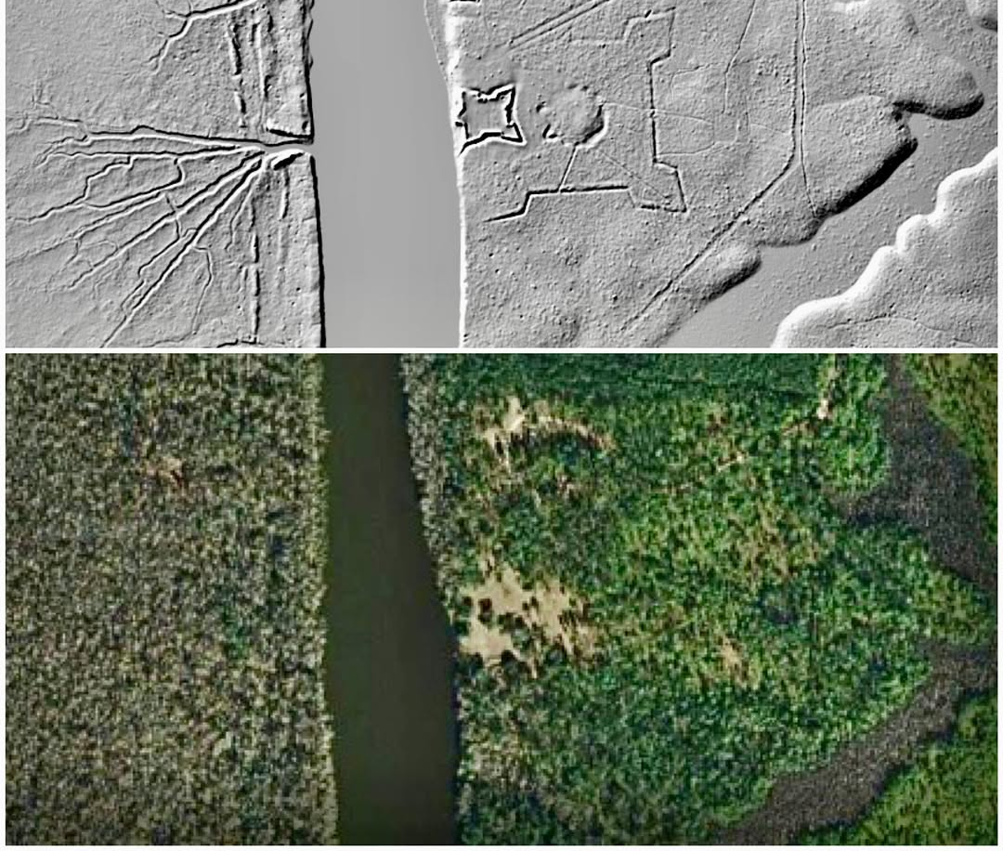
Negro/GadsenFort

Slide 11
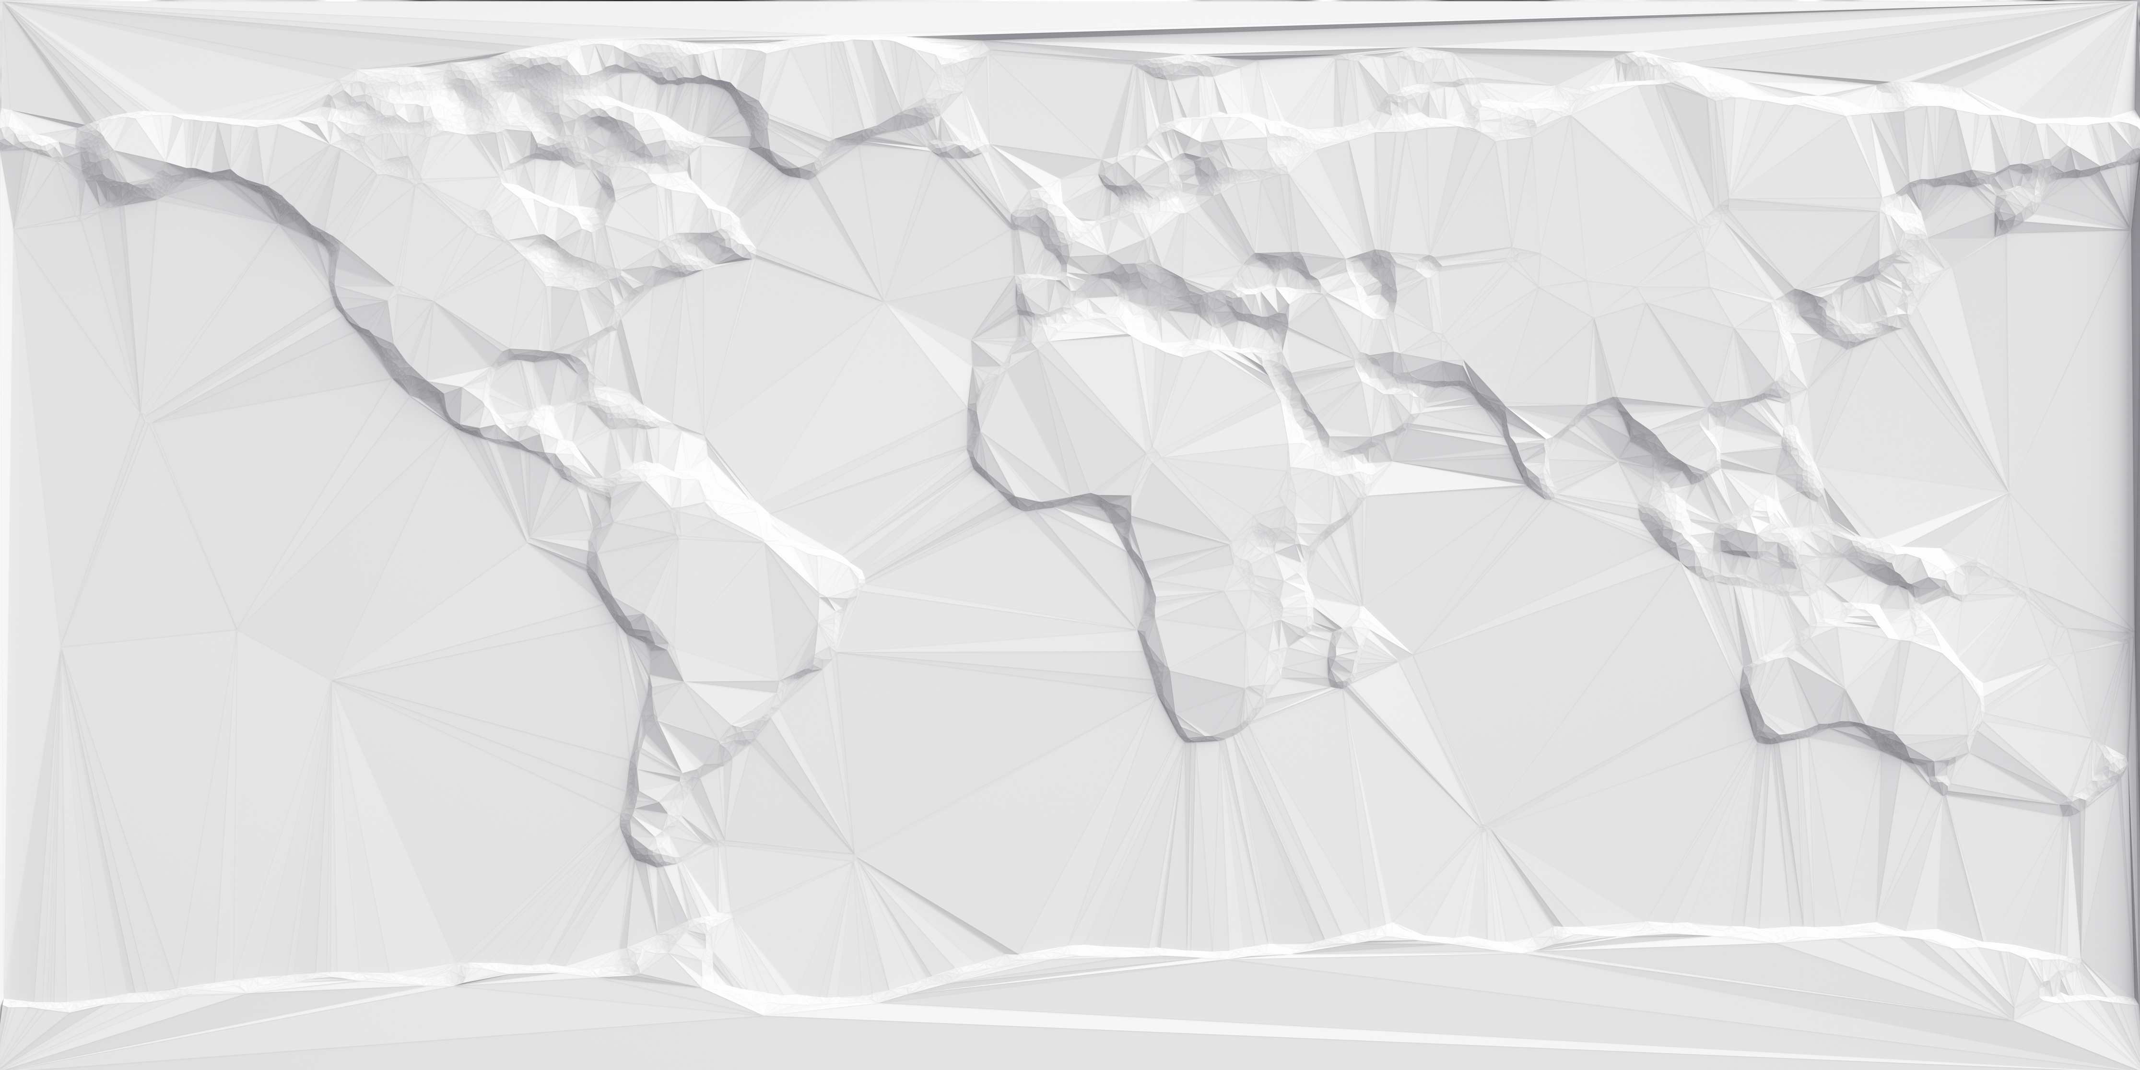
Lidar Hillshade
Explorer

Slide 12
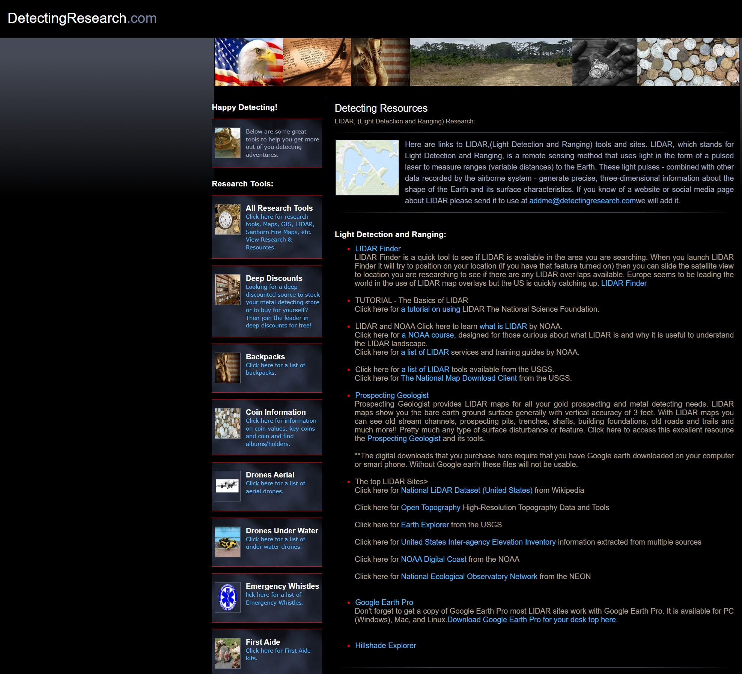
Download file from Detecting Research

Slide 13
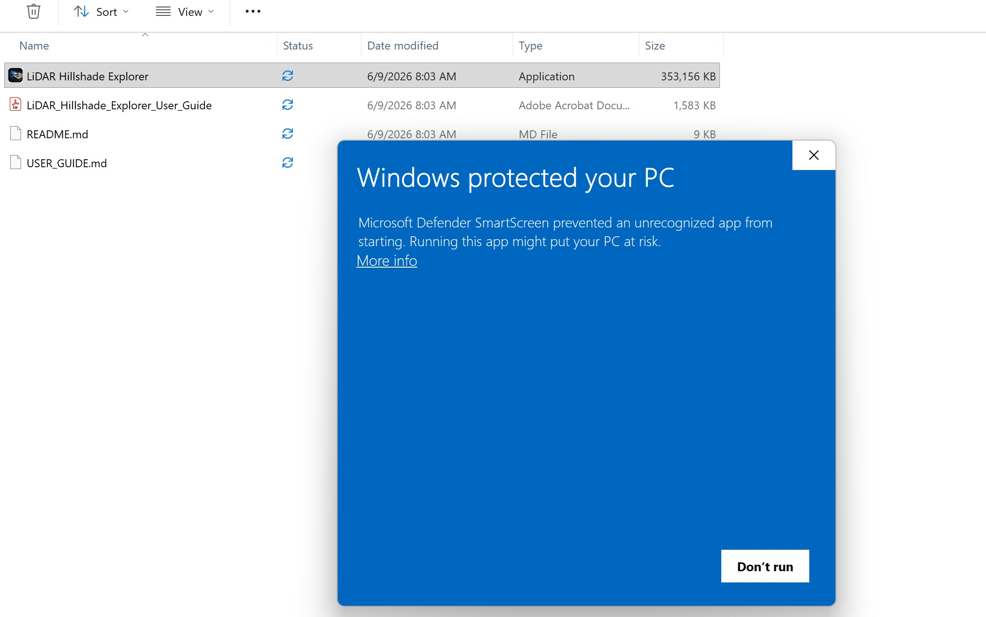
Click on More Info

Slide 14
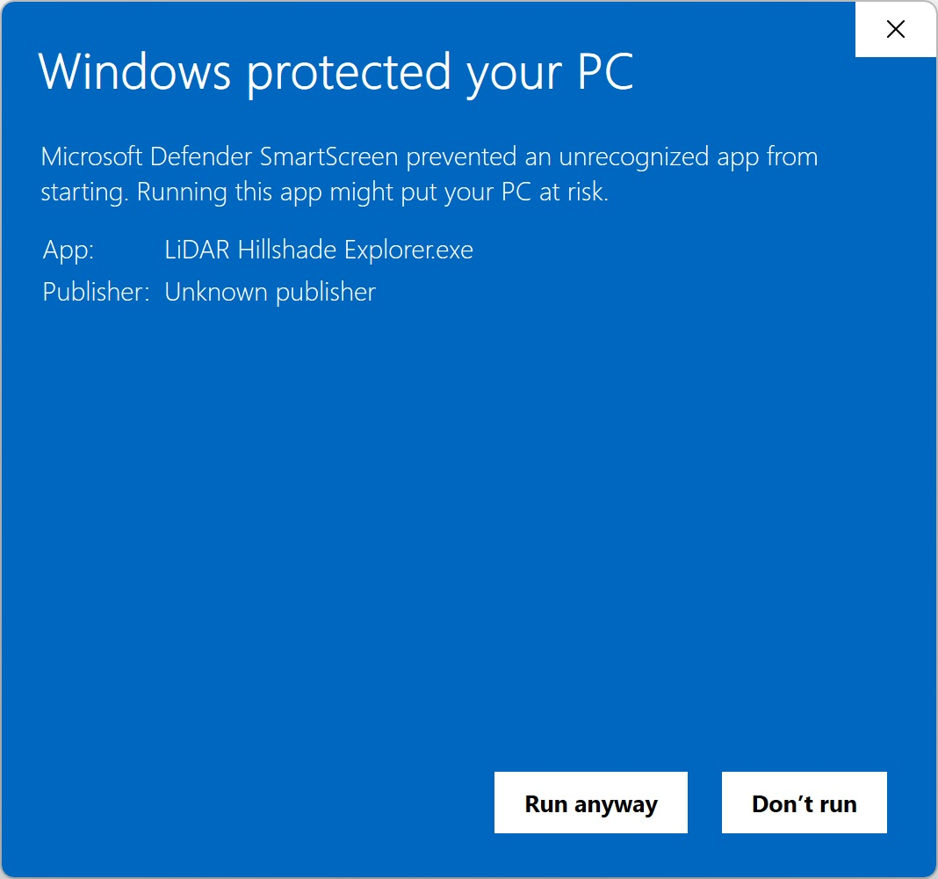
Click on Run Anyway

Slide 15
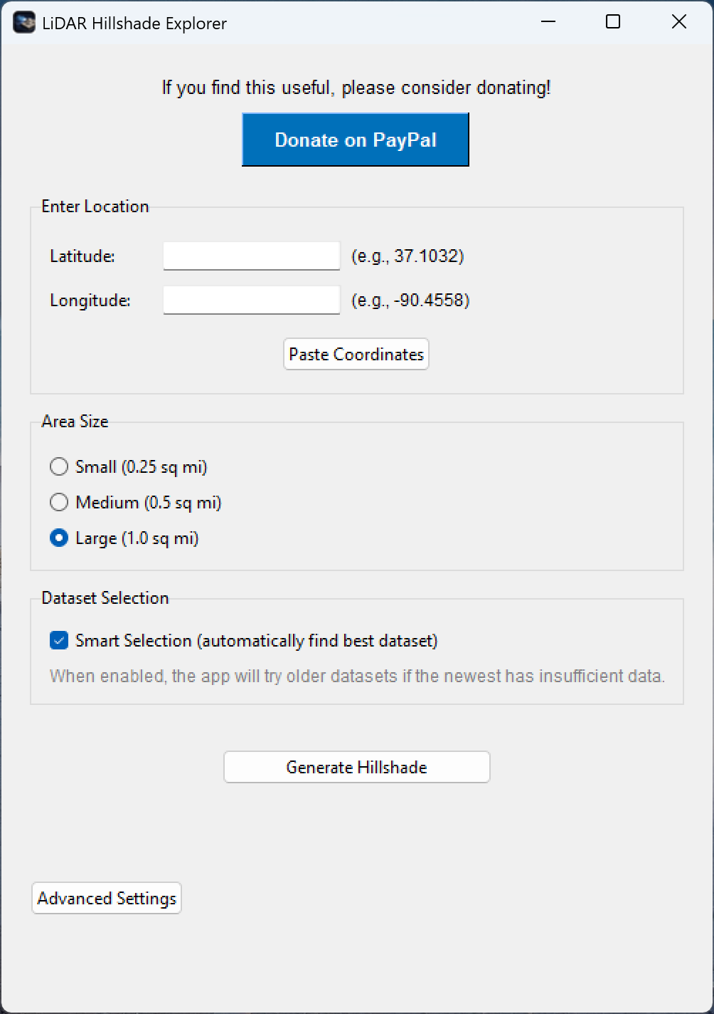
Once installed you will get the following screen

